Slide 1
BRITISH AIRWAYS
Data analysis for costumer reviews

Slide 2
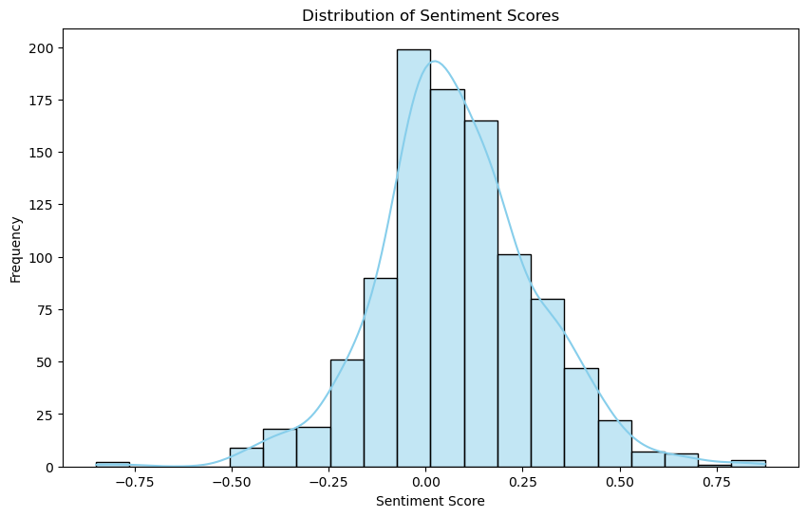
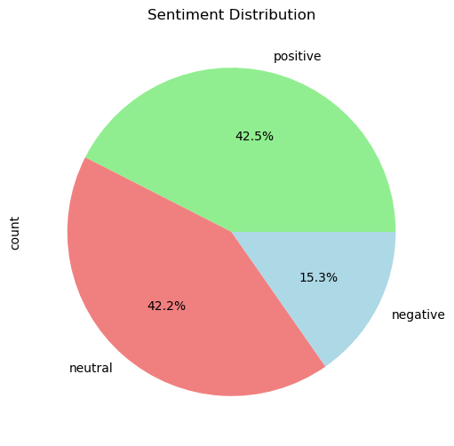
Sentiment Analysis Insights
1. Data Overview:
Total Reviews: 1000
2. Sentiment Distribution:
Positive: 425| Negative: 153 | Neutral: 422
Visual: Display a pie chart for sentiment distribution
Display a bar chart for sentiment scores
3. Top Insights:
Top words in positive reviews | Number of those words | Top words in negative reviews | Number of those words
flight | 1756 | flight | 867
ba | 551 | verified | 2192
verified | 4345 | ba | 258
trip | 4183 | trip | 2119
good | 1904 | service | 1832
service | 3626 | london | 1231
crew | 1173 | british | 341
food | 1780 | airways | 156
time | 4104 | airline | 149
london | 2465 | hours | 1035
4. Recommendations: Enhance customer service, streamline operations, and implement communication strategies to address specific concerns identified in customer reviews.
5. Continuous Improvement: Establish regular sentiment analysis, feedback loops, and employee training, leveraging technology for ongoing enhancements in line with customer expectations and industry trends.

